Slide 1
Potato Chip Mailing Contest
SIX

Slide 2
Objective/Requirements
Build a container that would hold a potato chip and mail it without breaking.

Slide 3
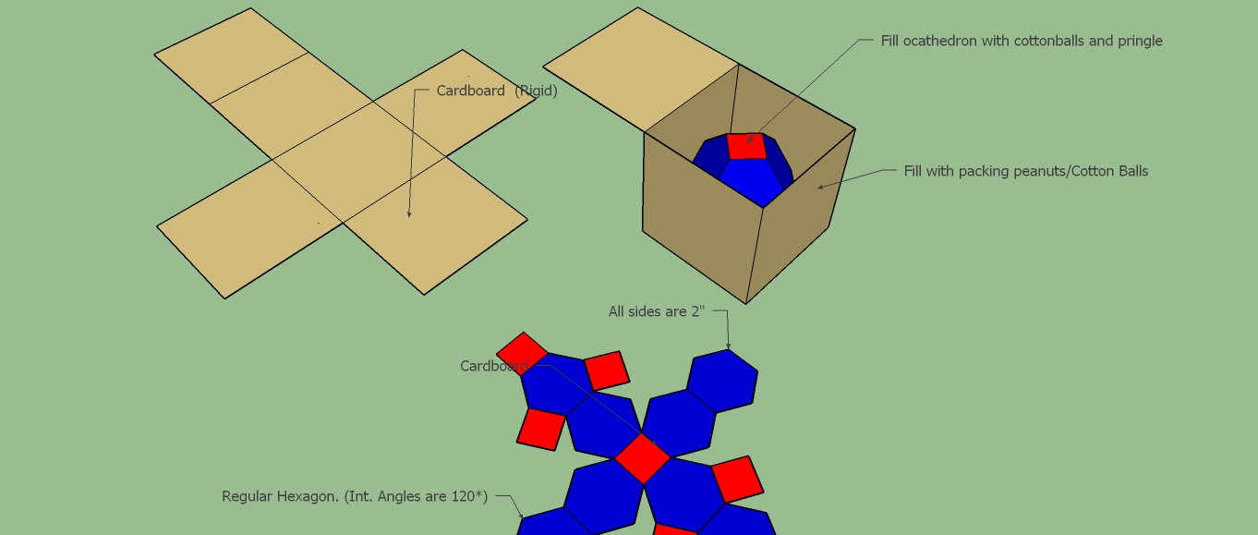
Design

Slide 4
Predicted Score with Explanation
30.2=100/0.47/0.32/1000)

Slide 5
Parts List
Cardboard
Packing peanuts
Tape
Cotton Balls

Slide 6
Photo of Mailed Container

Slide 7
Data
Official Score

Slide 8
Lessons Learned
What worked well
What would you change next time
If your predicted score differed from your actual, why?

